Slide 1

MOBILE APPLICATION FOR WOMEN SAFETY
SUBJECT NAME: Software Testing for MOBILE APPLICATION
SUJECT CODE: CSA3732
STUDENT NAMe: V.BHARATH
REG.NO: 192011278
DEPARTMENT: C.S.E
Date:13/02/2023

Slide 2
OBJECTIVES:
1.Main aim of this project (Mobile application for women safety )is to get rid of the problem which are faced outside the door.
2. The safety of a women is concern of increasing the urgency in India and other countries to prevent them from responding quickly calls and distress.

Slide 3
ABSTRACT:
In today's world, people using smart phones have increased rapidly and hence, a smart phone can be used efficiently for personal security or various other protection purposes.
The safety of a women is concern of increasing the urgency in India and other countries to prevent them from responding quickly calls and distress.
This is women safety application built in android Studio for beginners. In this project we first take mobile number where we are going to send SMS when user is in the trouble . App is going to send last known location of user to registered number as well.

Slide 4
ANDROID PROJECT IDEA:
The women’s safety application will aim at providing the utmost safety to women. All they need to do is register themselves on the application and as soon as they sense something shady, they’ll press the power button thrice, and consequently, their location will be sent to the nearest police station and emergency contacts.
If the woman reaches a safe space, she can press the stop button. This will have three modules- Admin module that will manage the application, view the user details, and track the location .
User module will be used by the women registered on the application. After registering themselves users would need to add details like emergency contacts, location etc.
Guardian module will be the well-wishers of the users . They will also have to register on the application .
This application would have a shake detector, which that means on shaking the device, SOS messages will be sent to registered contact numbers.
It will also send the last known location with a google map link to registered contacts .

Slide 5
PROCEDURE:
Coming to the usage of this app it is very easily used.
Just few steps need to be followed.
Install the app from link.
Then enter particular mobile number for which the SMS need to be forward.
Once entering the mobile number once shake the mobile.
After shaking the mobile ,the number which you have entered the location will shared.

Slide 6

Tools/languages required:
Android studio IDE.
Xampp.
Android SDK .
Android emulator.
Java and basic XML.
Firebase authentication.
Real time database.

Slide 7

TEST CASE:
LOGIN
USER LOGIN DETALIS
MOBILE NUMBER
SMS & MESSAGE
LOCATION
REPLY FOR MESSAGE
FINDING SEVERS
REPORT LOCATION

Slide 8
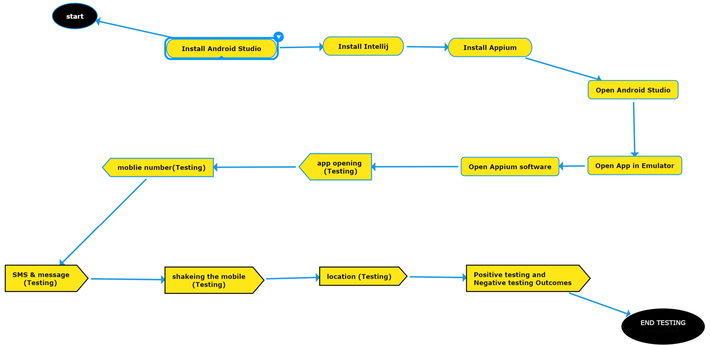
FLOW CHAT:

Slide 9
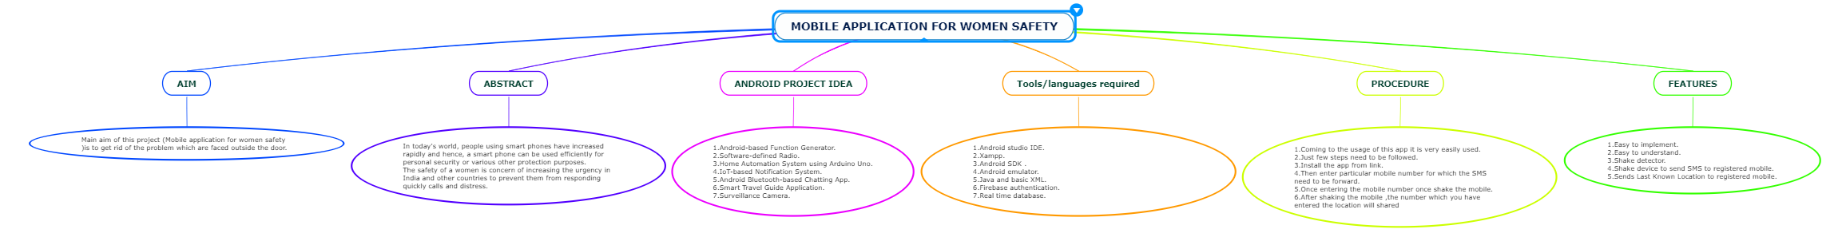
CONCEPT MAP:

Slide 10



Applications Used

Slide 11
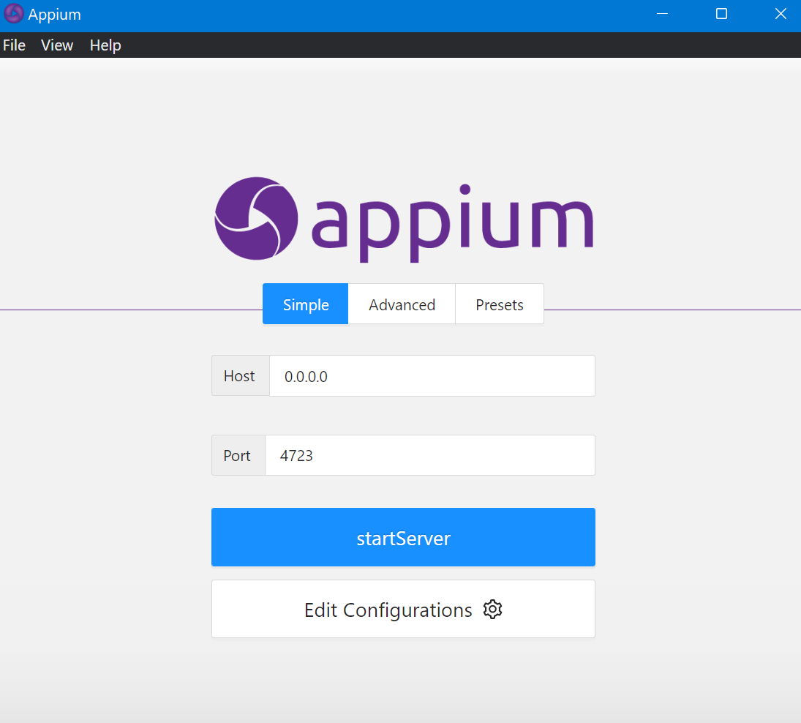
APPIUM SERVER

Slide 12
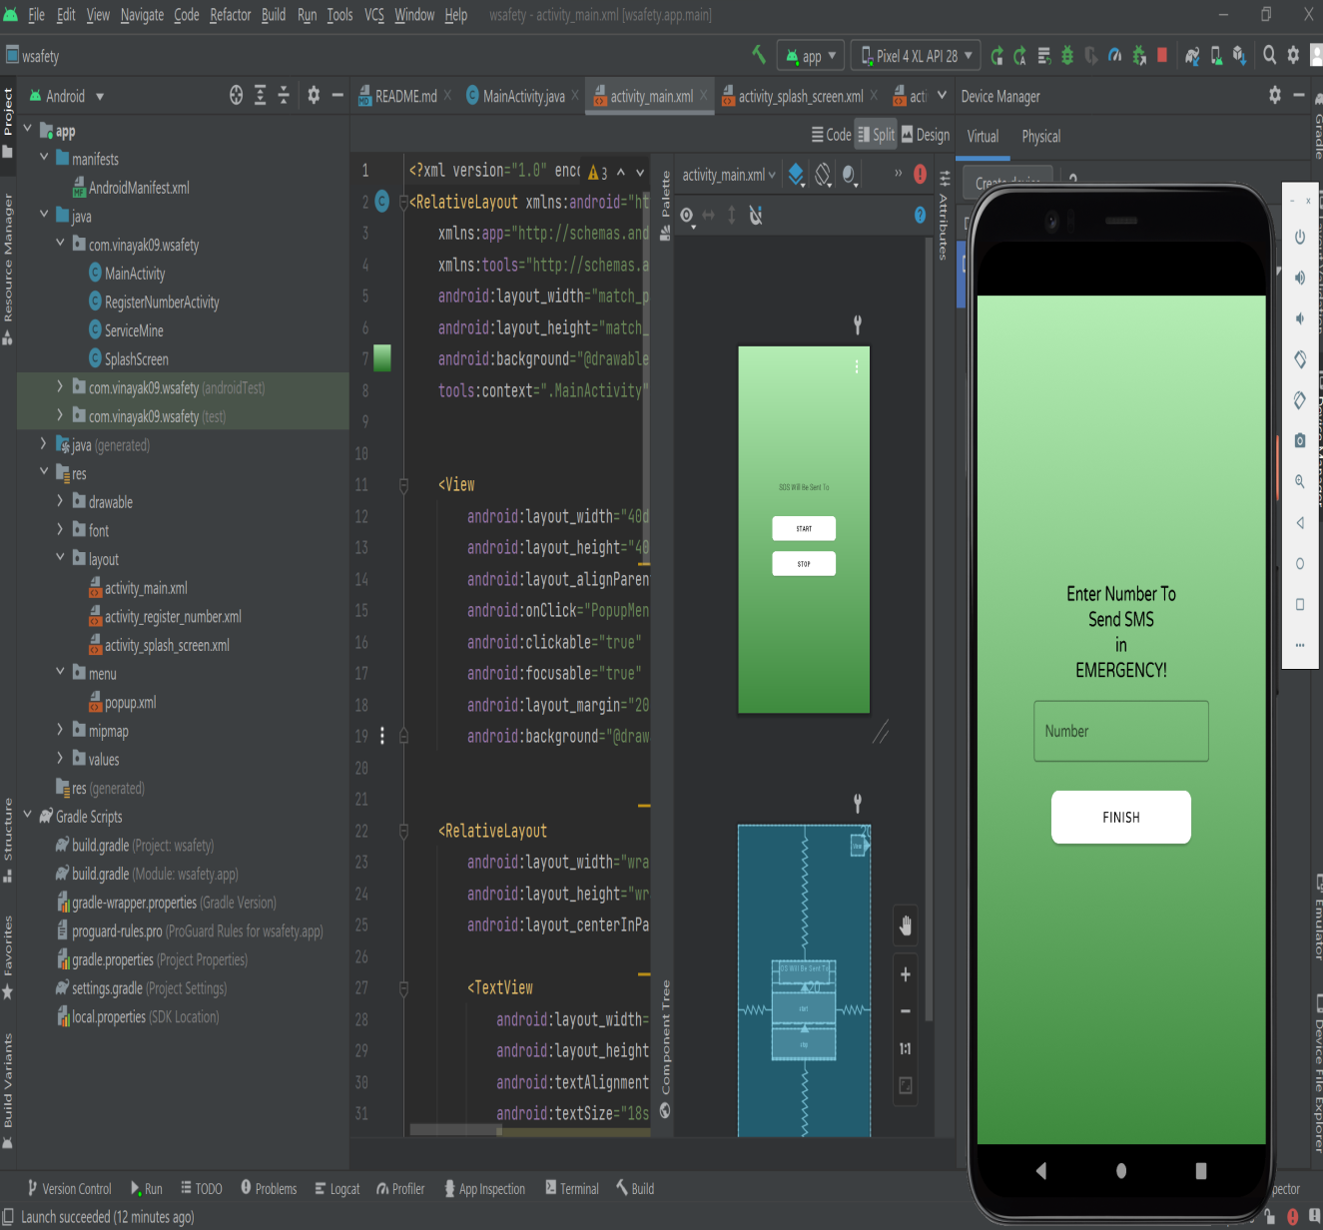
ANDROID STUDIO

Slide 13
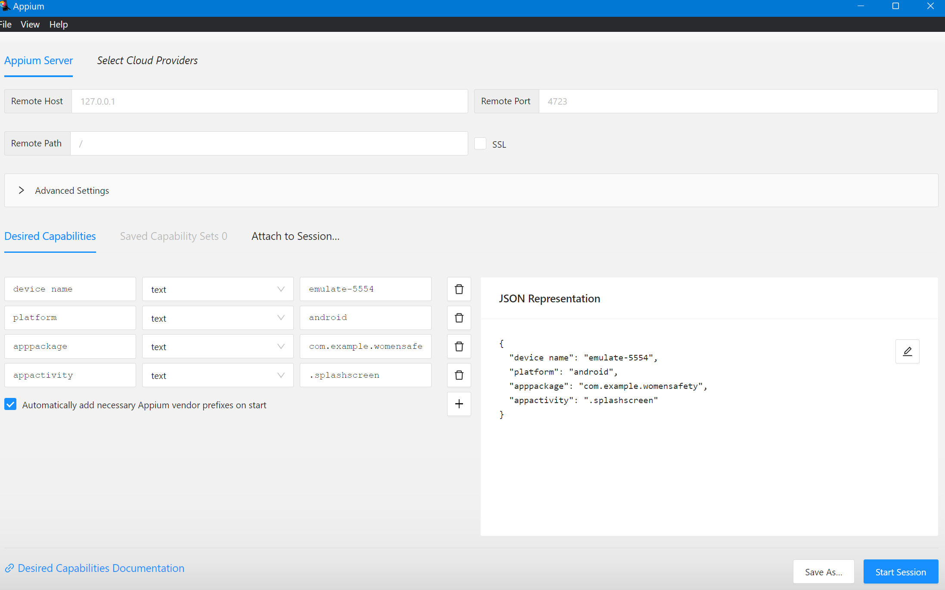
IMPLENTATION AND TESTING

Slide 14
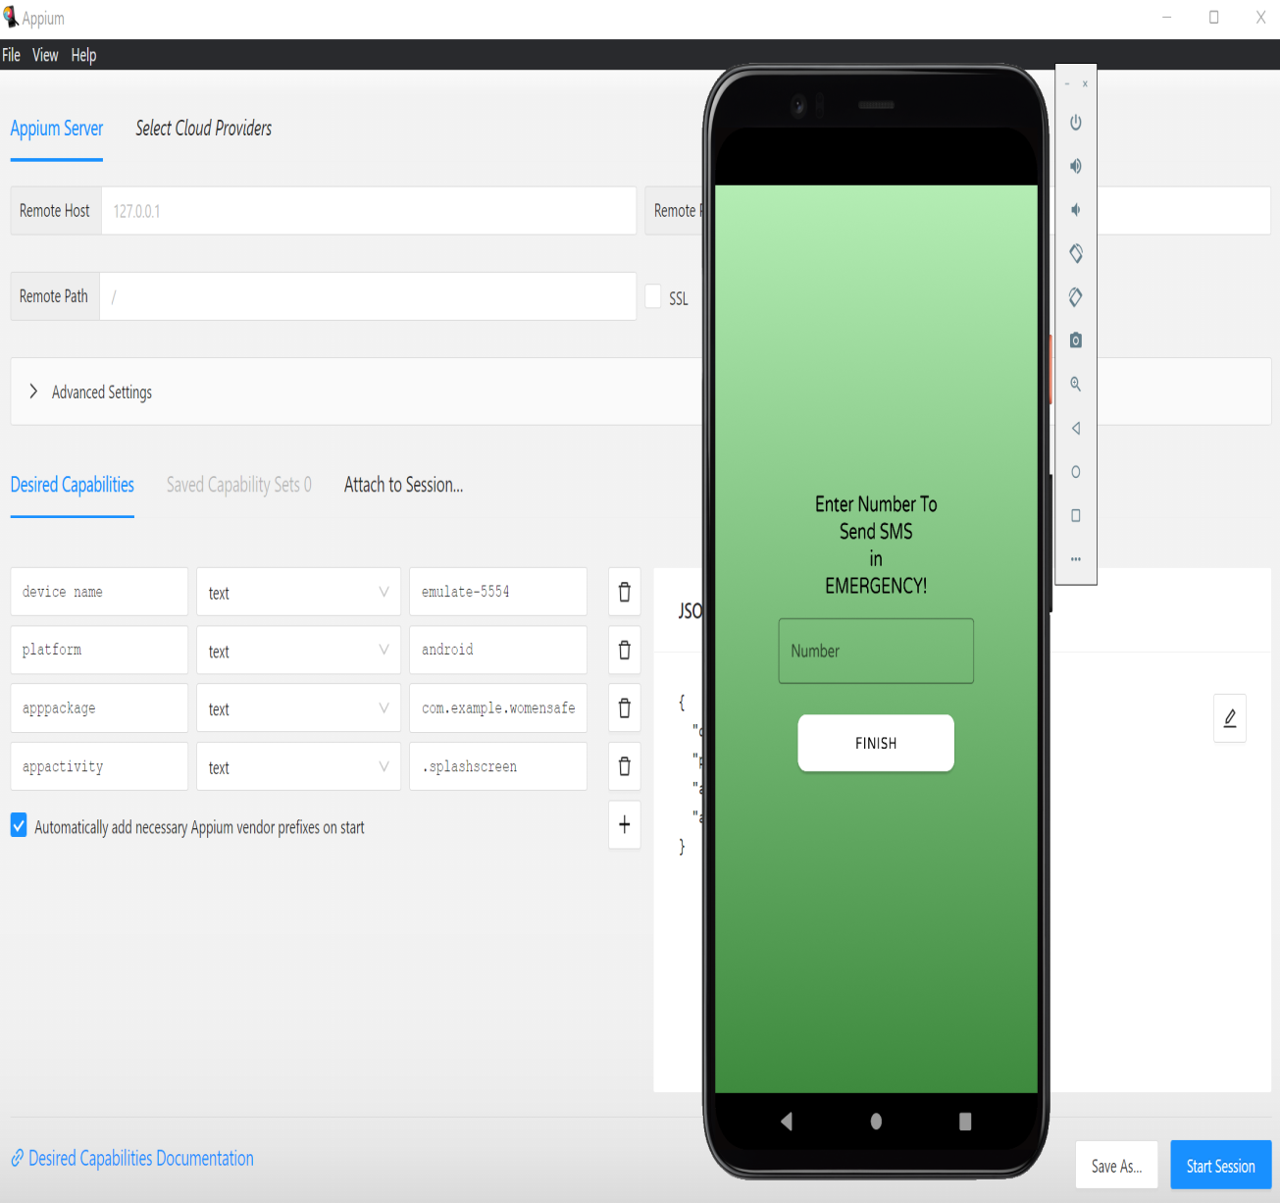
OUT PUT

Slide 15
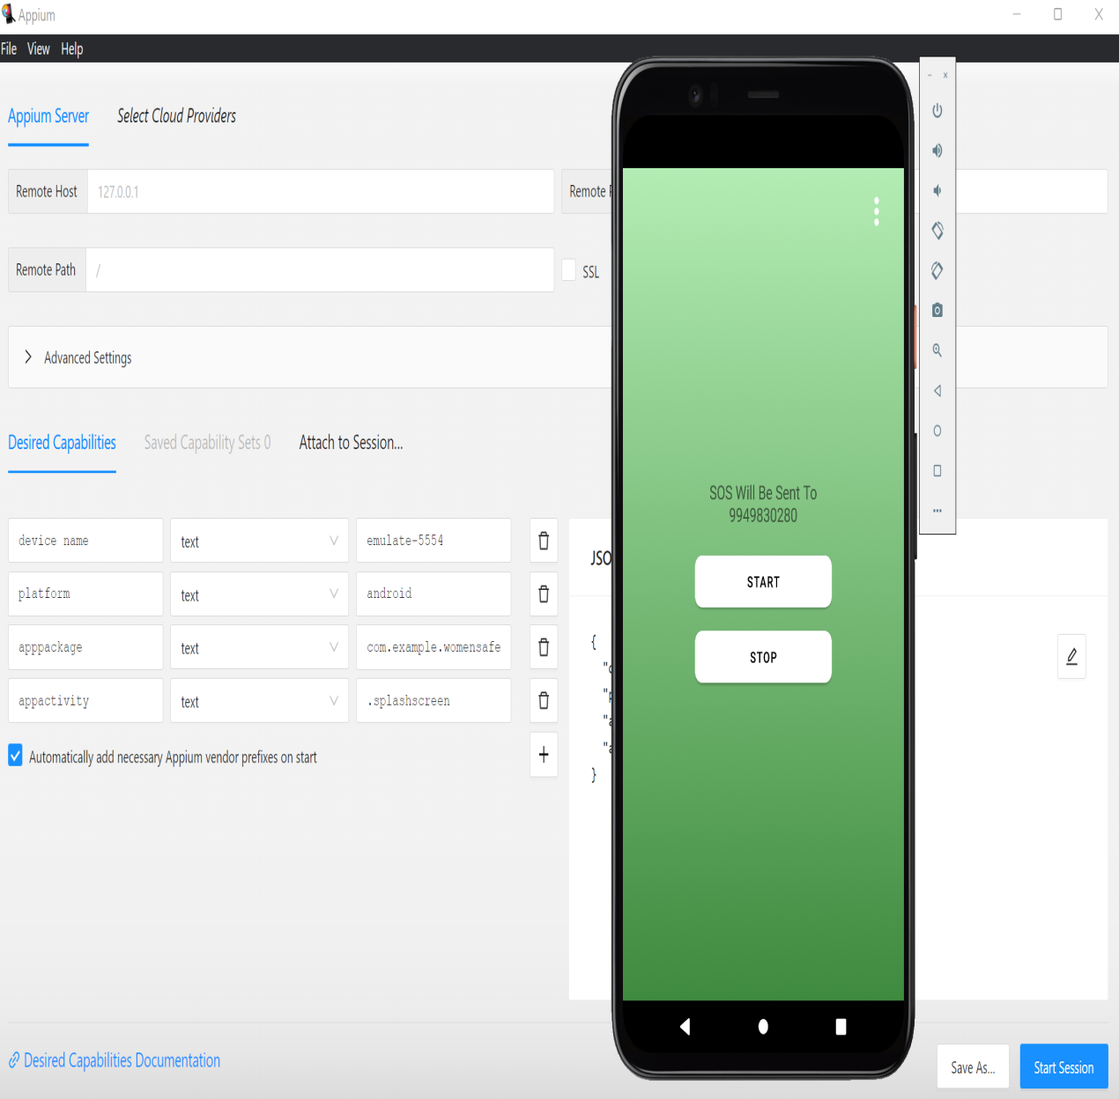
OUT PUT

Slide 16
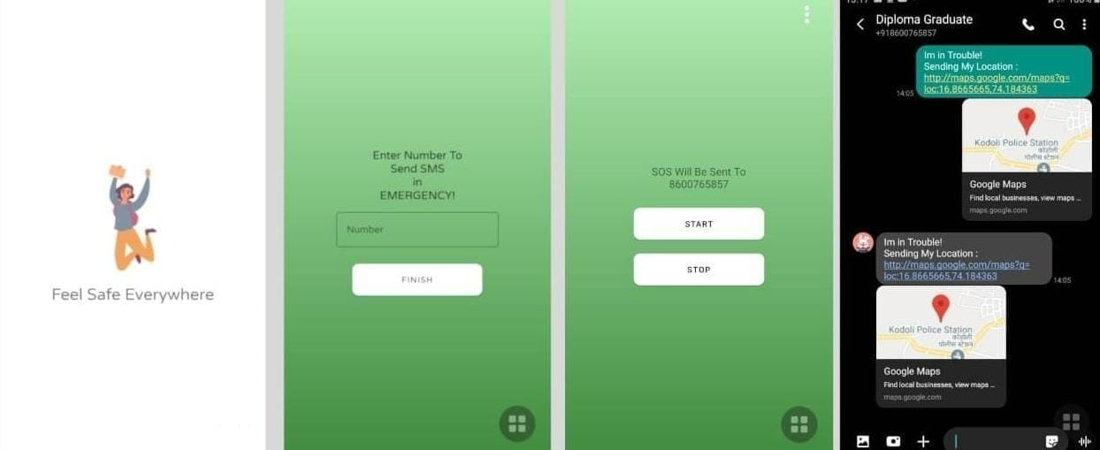
OUTPUT OF THE INTERFACE OF APPLICATION:

Slide 17
Test case outcomes
TEST CASE | RESULT
Verify if a user will be able to login with valid OTP and mobile number. | positive
Verify the User can be start the service by pressing the start button in interface of the app. | positive
Verify the Tracking issues! By real time and User can be sending the current location are not for the saved contacts. | positive
Verify the user can be getting the Messages are not getting delivered to emergency numbers. | positive
Verify the Contacts are saved and user can be change the user number. | positive
Verify By shaking the phone at any angle message was sent are not. | positive
Verify the User can be stop the service by pressing the stop button. | positive

Slide 18
CONCLUSION:
1.Thus the above android application has been developed successfully.
2.When the safety and security are considered, women in Indian society are becoming the most vulnerable section.
3.Another useful feature is the implementation of accelerometer
4.On a simple touch, the user can safe their life from molesters
5.The app provides a number of useful features which are very helpful for women.

